Slide 1
Review: MS-PS3-4
I can determine factors that affect thermal energy transfer.

Slide 2
Scenario #1
Cup A had 20 ml of 100 C water added to 5 ice cubes.
Cup B had 200 mL of 22.2 C water added to 5 ice cubes.
Explain why the ice in cup B melted faster than the ice in cup A.
A
B

Slide 3
SCENARIO #2
Why might the baby be wearing a hat and heavy coat?
Draw an arrow showing the direction of heat (energy) transfer.

Slide 4
Scenario #3
Cold whipped cream is added to a cup of hot coffee.
What will happen to the whipped cream over time (if the cup sits out on the classroom table)?
Draw the direction of heat transfer.

Slide 5
Scenario #4
If room temperature soda from the store is placed in a cooler of ice, what will happen to the soda?
Explain what will happen to the ice?
Draw an arrow to show the direction of the heat transfer.

Slide 6
SCENARIO #5
Why is it important to keep the refrigerator door closed?
Draw the direction of heat transfer.

Slide 7
SCENARIO #6
Draw an arrow to show the direction of heat flow?
Why does the ice feel cold?

Slide 8
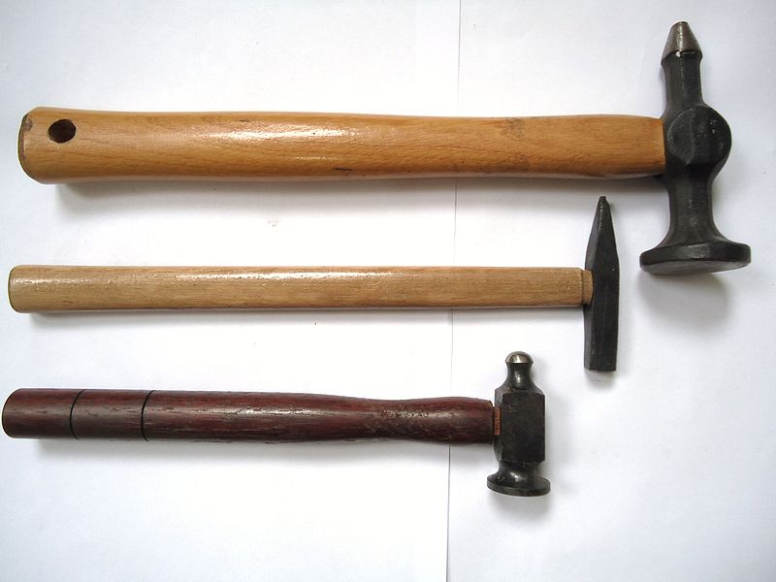
Scenario #7
Can the objects at right have the same temperature but different amounts of thermal energy?
Explain your answer.

Slide 9
Exit slip 1
https://forms.gle/UNbnaR83K4Q5dzFj9

Slide 10
Exit slip 1.1
https://tinyurl.com/y4b2ltoa

