Slide 1
Is it Living?
What are the characteristics of living things?

Slide 2
Learning Targets:
I can identify the characteristics of living things.
I can distinguish between living and nonliving things.
I can understand that living things may be unicellular or multicellular.

Slide 3
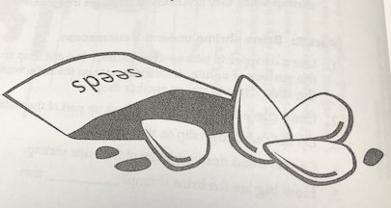
MONDAY, DECEMBER 9th, 2019
Copy homework into planner:
Study notes on C.O.L.T. (characteristics of living things)
FINISH dormancy question
Team member number 2: Water seeds in Styrofoam cups.
Observe at your table.
What are the Needs of Seeds?
Refer to zip loc bag at front table as well as your seed.
Discuss as a class.
Open packet to 5-Vials data tables for discussion. Team member number 3 get table bin with 5 vials.
What were the differences?
What were the similarities?
Discuss “dormancy.”
Review exit slips from last Friday.

Slide 4
Dormancy
Some organisms may seem to be nonliving until placed in the right environmental conditions (water, salt water, sugar water, etc.) to grow. This condition is called dormancy.
How does the 5-Vials lab demonstrate the concept of dormancy?
Answer in your notes using complete sentences and examples from the lab.
You may also use examples from nature.
https://www.youtube.com/watch?v=GFEgB_ytDZY

Slide 5
TUESDAY, DECEMBER 10th, 2019
Copy homework into planner:
Study notes on C.O.L.T. (characteristics of living things).
Study structure and function of seed parts.
Team member number 4: Water seeds in Styrofoam cups.
Observe at your table.
Team member number 1: Get gray bins with seeds.
Perform Seed Dissection.
Sketches should be detailed, labeled and colored (as needed).
To “soak” the seed, place it in your mouth for 5 minutes while you answer the questions that follow.

Slide 6
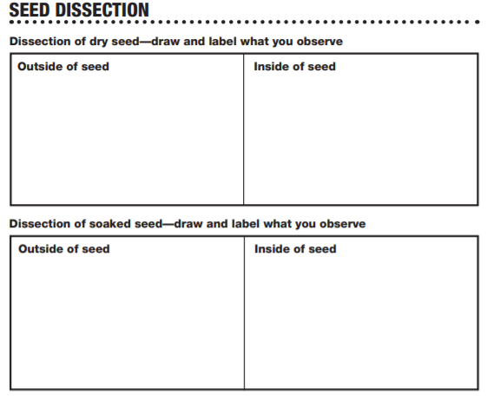
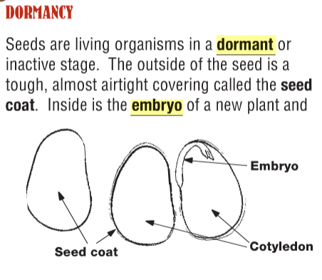
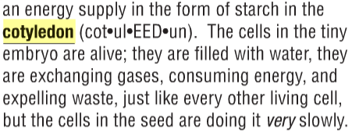
Seed Dissection

Slide 7
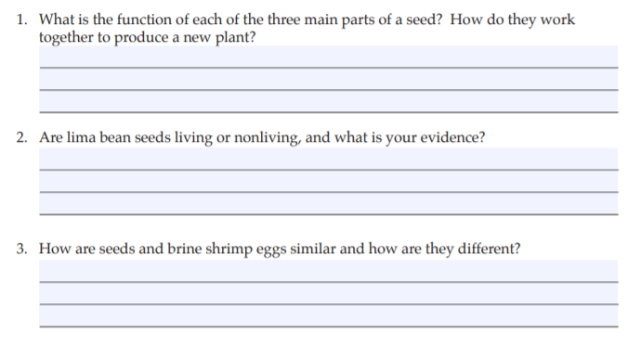
Seed Dissection Continued

Slide 9
Microscope Introduction

Slide 10
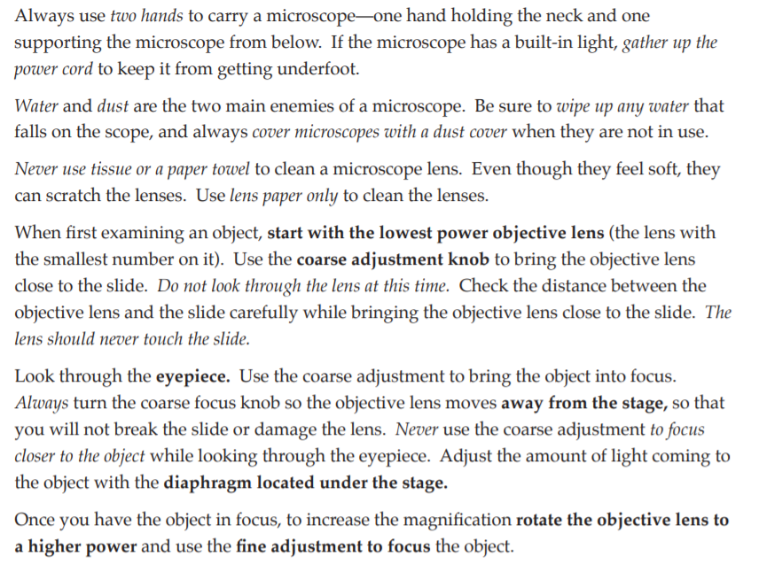

Slide 11
Microscope Use and Care
View the Lab Techniques videos:
https://www.fossweb.com/delegate/ssi-wdf-ucm-webContent/Contribution%20Folders/FOSS/multimedia_ms_1E/DiversityofLife/labHtml/lab-1.htm
Moving the Microscope
Learning the Parts of a Microscope
Label the parts of the microscope on the diagram in your packet.
Focusing the Microscope
Making a Wet Mount

Slide 12
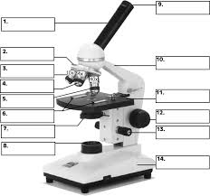

Slide 14
WEDNESDAY, DECEMBER 11th, 2019
Copy homework into planner:
Study notes on C.O.L.T. (characteristics of living things).
Study structure and function of plant parts.
Team member number 2: Water seeds in Styrofoam cups.
Keep at table and observe.
Odd numbered team members: Get microscopes
Directions for today’s microscope use
Making a wet mount of roots and stems.

Slide 15
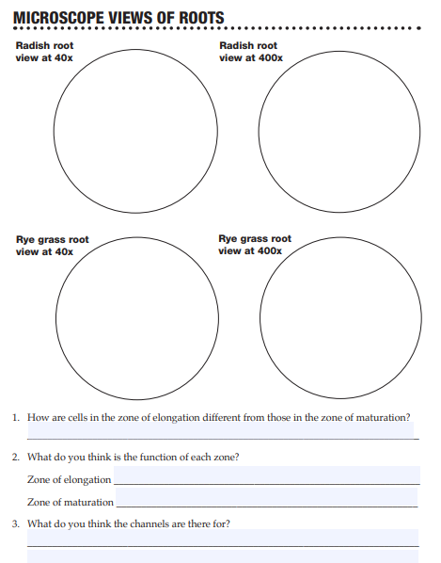
Microscope Views of Roots
Complete pages 35 - 36 of your packet.
Use the online text pages to assist in answering the questions that follow.

Slide 16
THURSDAY, DECEMBER 12th, 2019
Copy homework into planner:
Study notes on C.O.L.T. (characteristics of living things).
Study structure and function of plant parts.
Team member number 3: Water seeds in Styrofoam cups.
Observe at your table.
Even numbered team members: Get microscope & supplies.
Microscope Views of Leaf & Stems

Slide 17
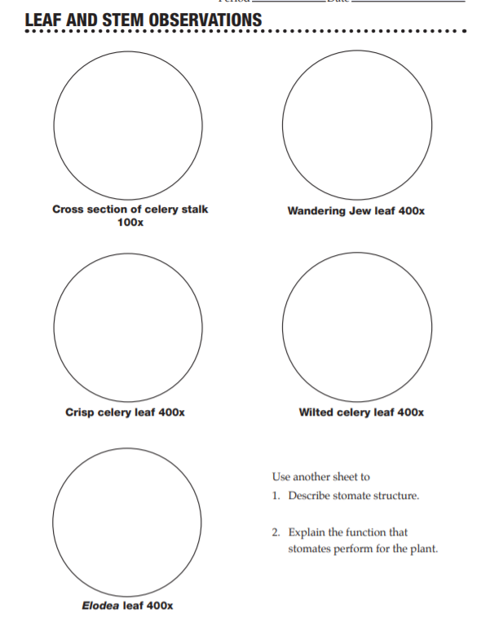
Leaf & Stem Observations

Slide 18
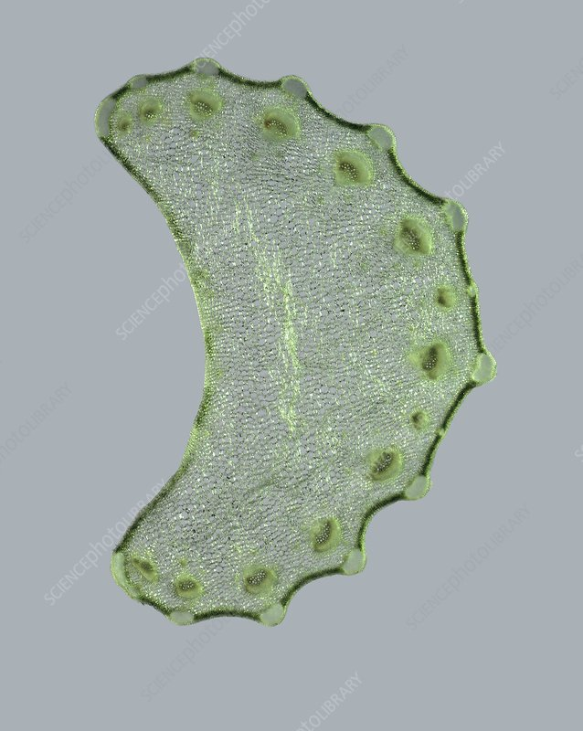
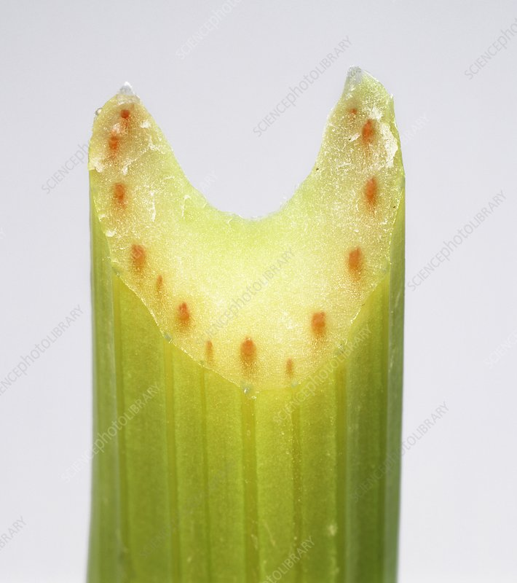
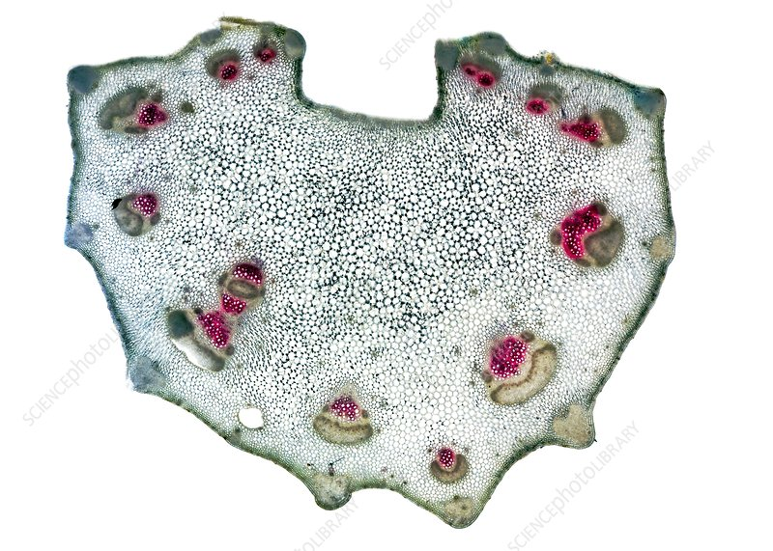
Celery Stalk

Slide 19
Celery Leaf

Slide 20
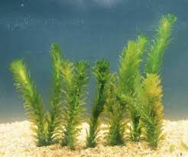
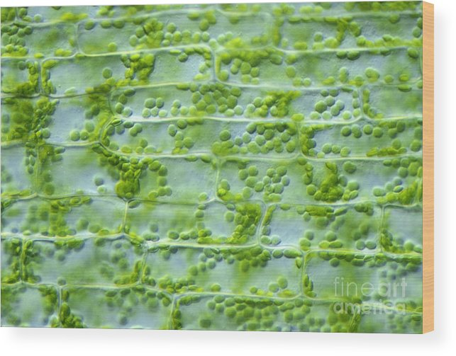
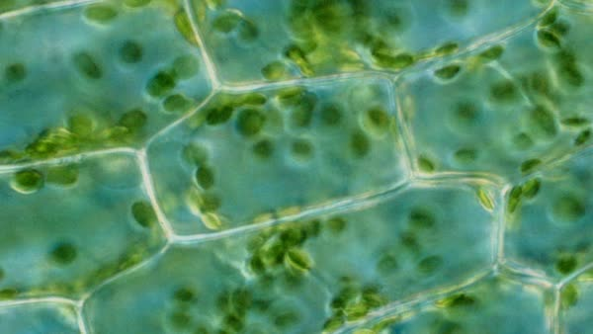
Elodea Leaf
400 x

Slide 21
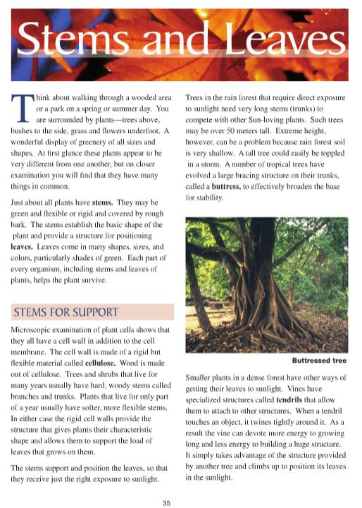

Slide 22
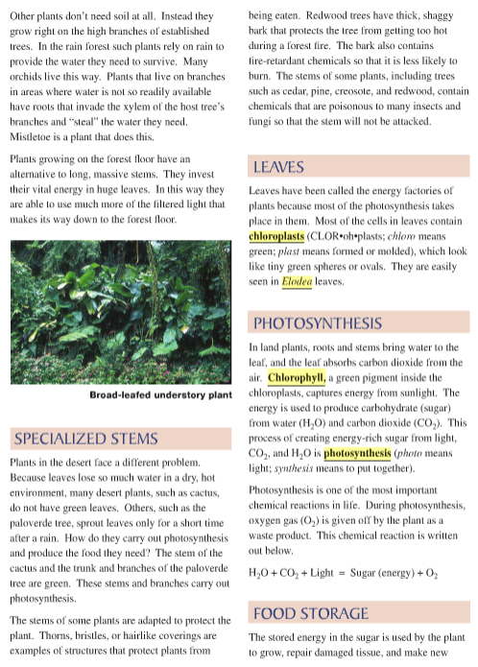

Slide 23
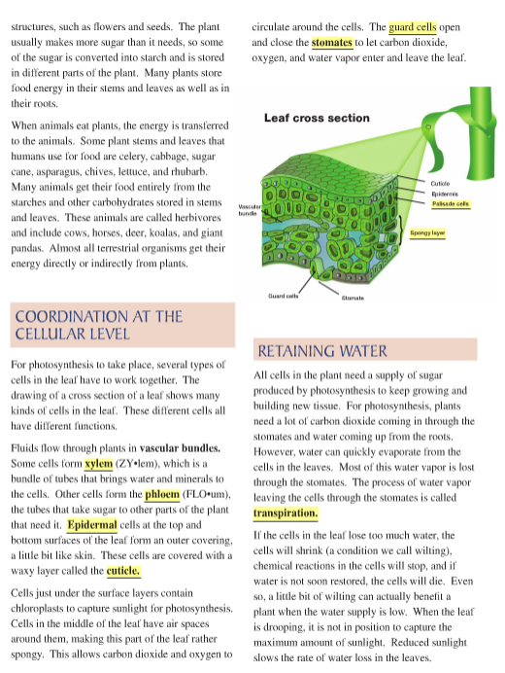

Slide 24
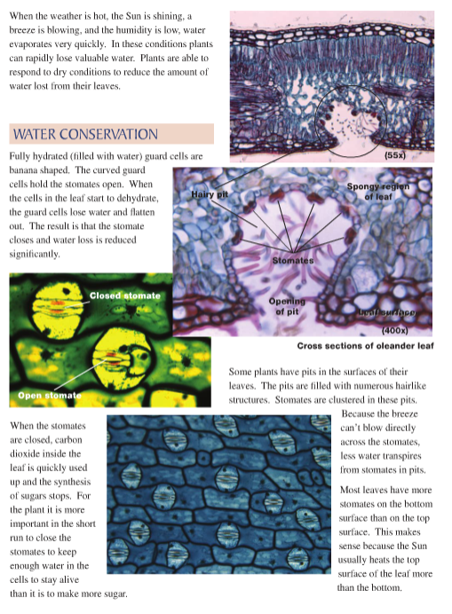

Slide 25
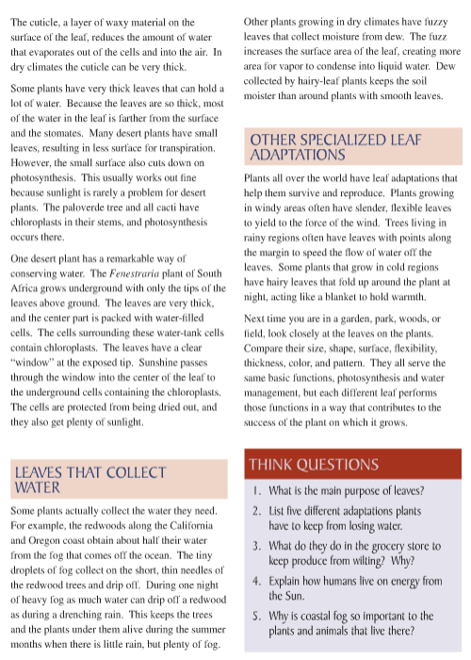

Slide 26
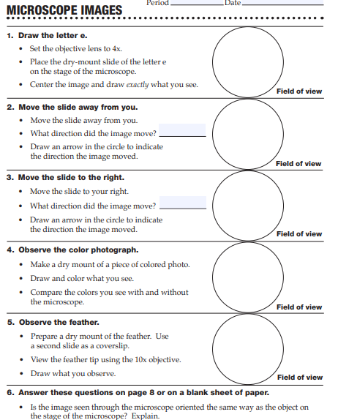
Taking a Closer Look

Slide 27
Prokaryotes vs. Eukaryotes
https://www.youtube.com/watch?v=Pxujitlv8wc

