Slide 1
Magnified Giving
Week 3

Slide 2
Empathy vs. Sympathy
https://www.youtube.com/watch?v=1Evwgu369Jw

Slide 3
Magnified Giving Website
Go to the Magnified Giving Website
http://www.mgprograms.org/
Click on “Students.”
Click on “Step 3.”
Discuss various N.P.O.s (non-profit agencies)
What is a 501c3?

Slide 4
Example: Brent Howell Recovery Foundation
https://www.guidestar.org/search
Enter Brent Howell Recovery Foundation in the search menu.
What does the bronze level mean?
Create a free account to access information for various N.P.O.s

Slide 5
Brent Howell Recovery Foundation, Inc.
What is the mission statement of this N.P.O.?
What is their “ruling year?”
What does “ruling year” mean?
Why does some of their information seem “NOT APPLICABLE?”
Discuss what services they DO provide.
What do their financials look like?

Slide 6
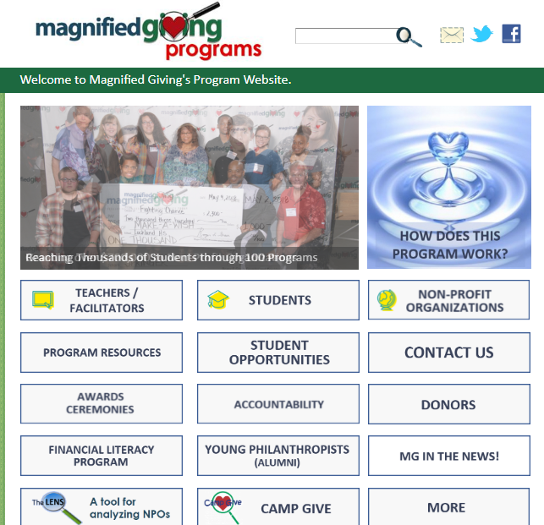
Go to Magnified Giving’s Page
http://www.mgprograms.org/

Slide 7
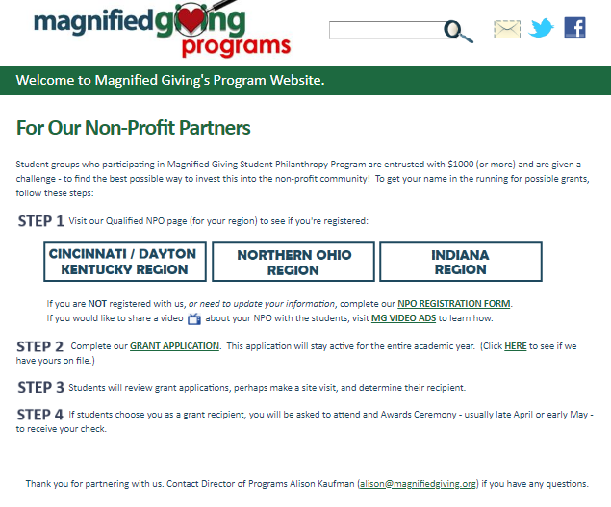
Click on Non-Profit Organizations

Slide 8
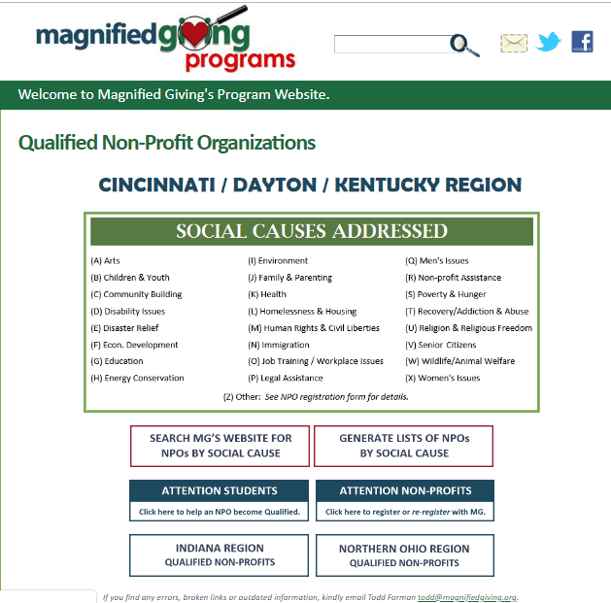
Click on Cincinnati/Northern Kentucky
Look at the social causes addressed and their symbols.
What symbol would you use for substance abuse?
Look at the non-profit organizations with that symbol.

Slide 9
Research Brighton Center
https://www.brightoncenter.com/

Slide 10
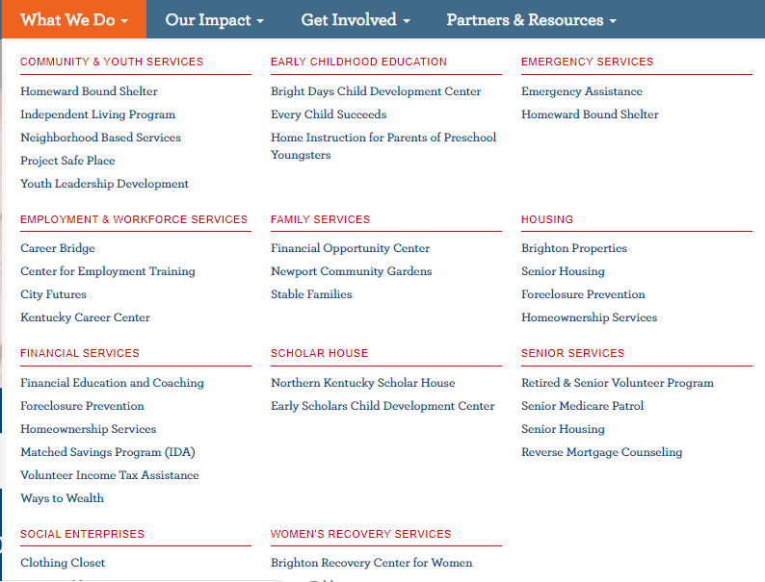
What does Brighton Center Do?

Slide 11
LENS Tool
Let’s complete the LENS tool together to evaluate financial accountability of various organizations.

