Slide 1
Mystery Mixture
Reaction

Slide 2
What were the reactants in the
Mixture reaction?

Slide 3
What were the reactants in the
Mixture reaction?
water + citric acid + sodium bicarbonate

Slide 4
What were the reactants in the
Mixture reaction?
water + citric acid + sodium bicarbonate
H₂O + C₆H₈O₇ + NaHCO₃

Slide 5
What were the products made during the Mystery Mixture reaction? Use your tiles to determine the products.
water + citric acid + sodium bicarbonate → ? + ? + ?
H₂O + C₆H₈O₇ + NaHCO₃ → _{? + ? + ?}

Slide 6
What were the products made during the Mystery Mixture reaction? Use your tiles to determine the products.
water + citric acid + sodium bicarbonate → gas + water + ?
H₂O + C₆H₈O₇ + NaHCO₃ → CO₂ + H₂O + ?

Slide 7
What were the products made during the Mystery Mixture reaction? Use your tiles to determine the products.
water + citric acid + sodium bicarbonate → gas + water + sodium citrate
H₂O + C₆H₈O₇ + NaHCO₃ → CO₂ + H₂O + Na₃C₆H₅O₇

Slide 8
Balance the equation. First write the equation.
H₂O + C₆H₈O₇ + NaHCO₃ → CO₂ + H₂O + Na₃C₆H₅O₇

Slide 9
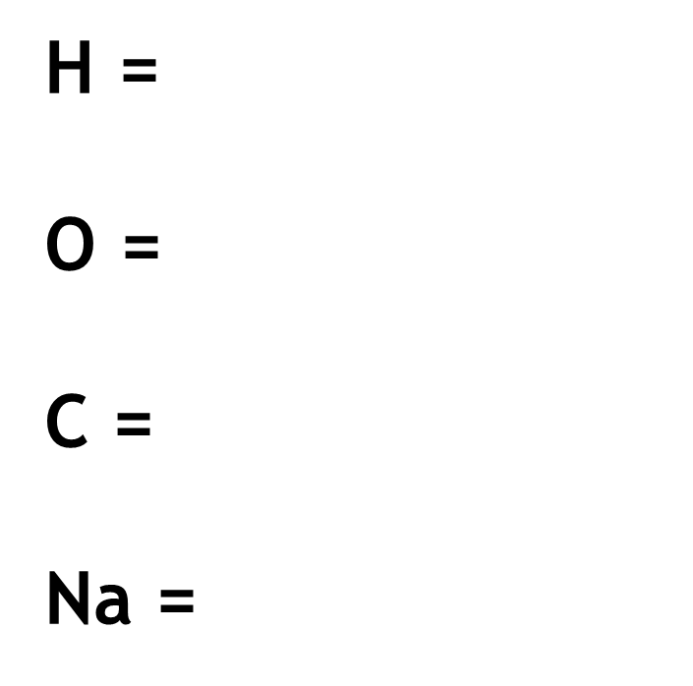
Secondly, separate the reactants from the products and write the elements on each side.
H₂O + C₆H₈O₇ + NaHCO₃ → CO₂ + H₂O + Na₃C₆H₅O₇
H =
O =
C =
Na =

Slide 10
Insert coefficients to balance the number of atoms on each side to meet the Law of Conservation of Mass.
H₂O + C₆H₈O₇ + NaHCO₃ → CO₂ + H₂O + Na₃C₆H₅O₇
H = 11
O = 11
C = 7
Na = 1
H = 7
O = 10
C = 7
Na = 3

Slide 11
The mystery mixture reaction balanced.
H₂O + C₆H₈O₇ + 3 NaHCO₃ → 3 CO₂ + 4 H₂O + Na₃C₆H₅O₇
H = 11 → 13
O = 11 → 17
C = 7 → 9
Na = 1 → 3
H = 7 → 13
O = 10 → 17
C = 7 → 9
Na = 3

Slide 12
Model of Chemical Reaction

