Slide 1
Specific Heat

Slide 2
Specific Heat Capacity: Elementary
https://www.youtube.com/watch?v=vmJXud8vHtg

Slide 3
Heat Exchange—Bozeman Science
https://www.youtube.com/watch?v=OBVbV5dpCCA

Slide 4
Specific Heat Capacity Introduction
https://www.youtube.com/watch?v=8CgL6P6o81I

Slide 5
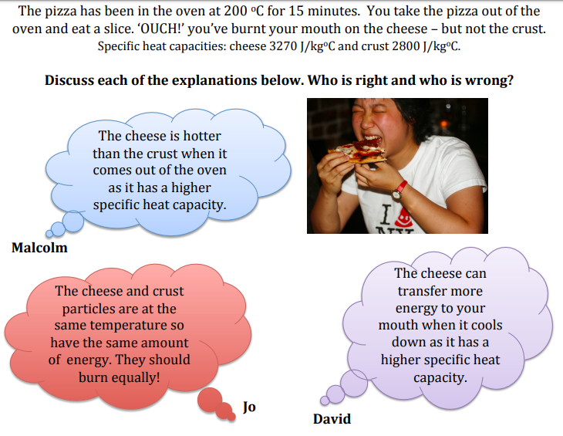

Slide 6
Malcolm

Slide 7
Jo

Slide 8
David

Slide 9
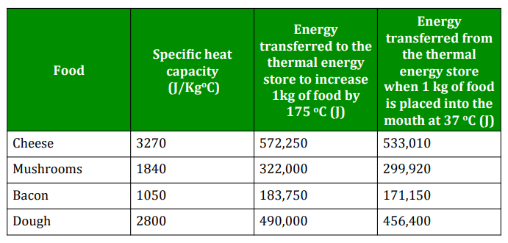

Slide 10
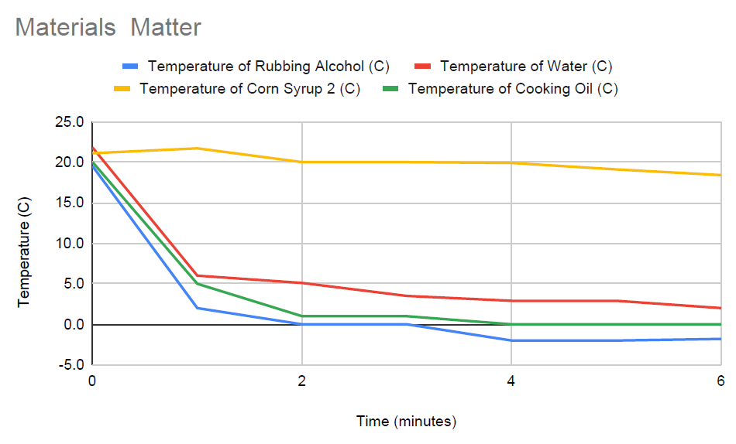
Which material has the LOWEST change in temperature according to the graph?
Which material has the HIGHEST change in temperature
according to the graph?

Slide 11
Which material has the LOWEST change in temperature according to the graph?
CORN SYRUP
Which material has the HIGHEST change in temperature
according to the graph?
RUBBING ALCOHOL

Slide 12
Which material has the LOWEST change in temperature according to the graph?
CORN SYRUP
Corn Syrup has the HIGHEST SPECIFIC HEAT CAPACITY
Which material has the HIGHEST change in temperature
according to the graph?
RUBBING ALCOHOL
Rubbing Alcohol has the LOWEST SPECIFIC HEAT CAPACITY

Slide 13
What is the relationship between… CHANGE IN TEMPERATURE and SPECIFIC HEAT CAPACITY?
If the materials start with the same volume and are exposed to the same amount of heat source (or cooling source s.a. ice), then …
The lower the temperature change, the greater the specific heat capacity.
The higher the temperature change, the lower the specific heat capacity.
THINK OPPOSITE!

Slide 14
Specific Heat Capacity Explained
https://www.youtube.com/watch?v=5we65e7EOcg&t=6s

