Slide 1
Week of
December 16th, 2020
Plant Reproduction

Slide 2
Monday, December 16th
Copy homework into your planner:
  Study C.O.L.T.s & Plants Structures and Functions for Summative Exam on Wednesday.
  Show parent/guardian letter about book.
Place all belongings on the floor except for packet and pencil and colored pencils.
Open to pg. 41—Parts of Flower
Study Jams: Parts of a Flower
  http://studyjams.scholastic.com/studyjams/jams/science/plants/flowers.htm
Flower Dissection

Slide 3
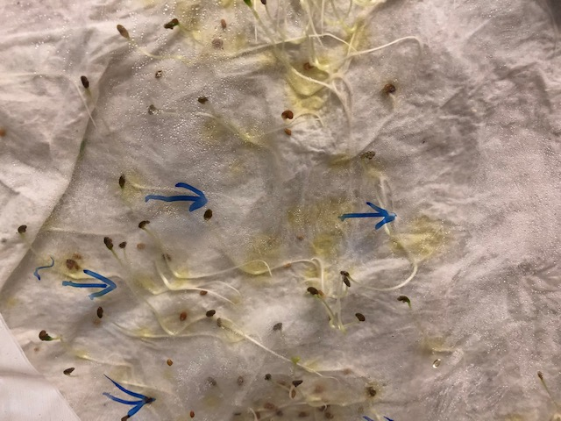
Rye Seed Germination and
Geotropism
The blue arrows show the direction of root growth the week of December 9th.
On December 12th I rotated the bag containing the seeds at a 90 degree angle to the right.
What is now happening to the root growth?

Slide 4
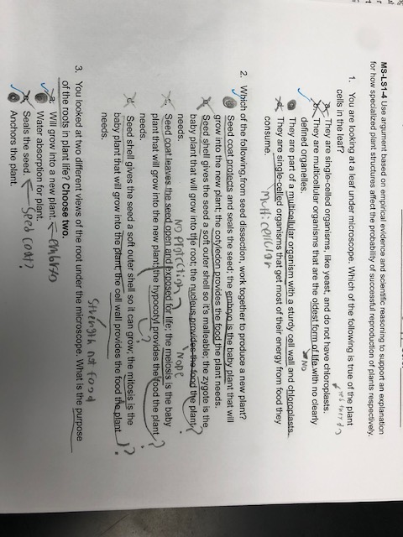
Exit Slip: Example of reading each answer choice

Slide 5
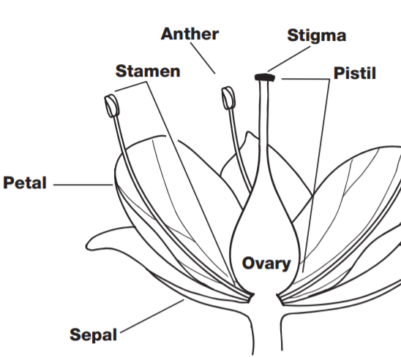
Parts of a Flower

Slide 6
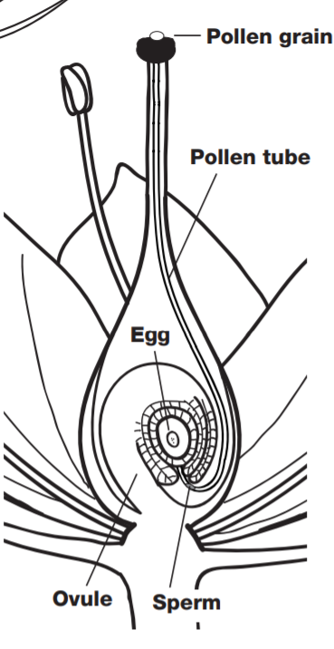
Pollination

Slide 7
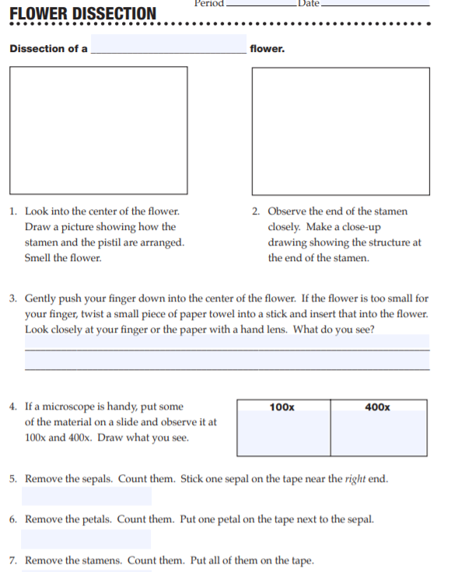
Flower
Dissection

Slide 8
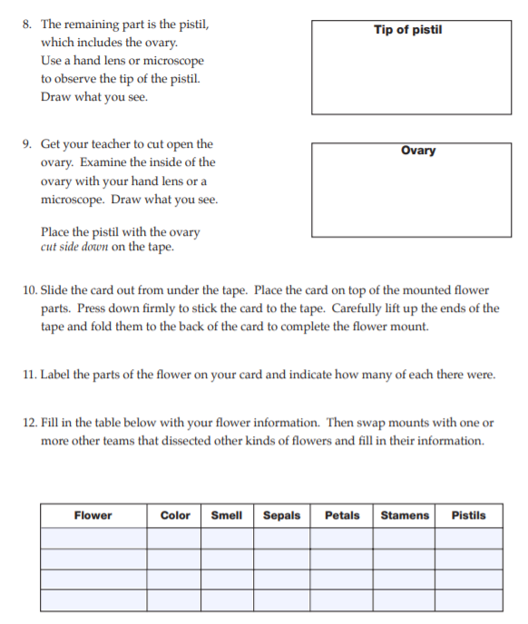
Flower Dissection (continued)

Slide 9
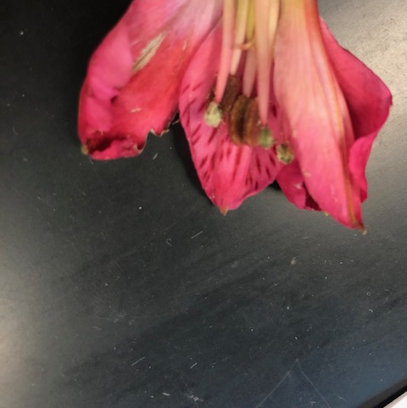
Pistil
&
Stamen

Slide 10
Stamen
Stamen: male part of the plant involved in reproduction
Filament: tall stalk that supports the anther
Anther: tip that produces and releases pollen (plant sperm)

Slide 11
Pistil
Pistil: female part of the plant
Stigma: top part; sticky so pollen can “stick” to it
Style: long slender part connecting stigma to ovary
Ovary: contains ovules (a.k.a. aggs.)

Slide 12
Tuesday, December 17th
Copy homework into your planner:
  Study C.O.L.T.s & Plants Structures and Functions for Summative Exam on Wednesday.
  Show parent/guardian letter about book.
Place all belongings on the floor except for chromebook, packet and pencil and science notebook. Take notes on the three short videos linked in the next slide.
Answer the RESPONSE SHEET—PLANT REPRODUCTION that follows in your science notebook. You may use any of your notes for assistance.

Slide 13
Pollination vs. Fertilization
Videos
View the following videos and take notes as you watch each.
https://www.youtube.com/watch?v=HLYPm2idSTE
https://www.youtube.com/watch?v=mix5torjiYc
https://www.youtube.com/watch?v=HP21hIVJhWI

Slide 14
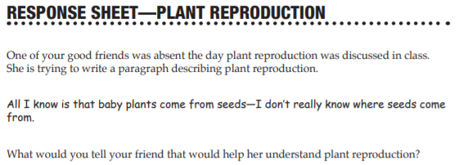
Answer the following prompt in your science notebook.
Use any resources available to you.

Slide 15
Answer to Response Sheet --Plant Reproduction
Pollen grains contain the male sex cell, the sperm.
After it lands on the stigma, the pollen grain grows a tube down into the ovule, located in the pistil.
The sperm travels down the tube into the ovule where it joins with the egg.
When the sperm fuses with the egg, the egg is fertilized.
The fertilized egg develops into an embryo, which is closed in the seed coat with the cotyledons.
The embryo, cotyledon, and seed coat make the seed.
The seed is the living baby plant in a dormant state.

Slide 16
Wednesday, December 18th
Copy homework into your planner:
  Think about who in your community needs help and what you could do to help them.
Place all belongings on the floor except for pencil and science notebook.
Discuss the RESPONSE SHEET—PLANT REPRODUCTION.
Answer Questions
Summative Assessment—TAKE YOUR TIME! READ AND REREAD.

