Slide 1
Week of February 10th, 2020

Slide 2
Monday, February 10th, 2020
Copy homework into planner:
No Homework
Take out supplies:
Your copy of The Immortal Life of Henrietta Lacks
Graphic organizer
Pencil
Read Chapters 12 – 14

Slide 3
Tuesday, February 11th, 2020
Copy homework into planner:
No Homework
Read and annotate Growth of Organisms
Exit Slip
Unit 3B: Exit Slip 4
https://tinyurl.com/tgjbgul

Slide 4
Wednesday, February 12th, 2020
Copy homework into planner:
Claim*Reasoning*Evidence worksheet due Friday to increase score for MS-LS1-5
Review Unit 3B Summative Assessment
(see exemplar responses on following slides)
Immortal Life of Henrietta Lacks
Chapter 14 (read together)
Chapter 15: read and annotate summary; discuss

Slide 5
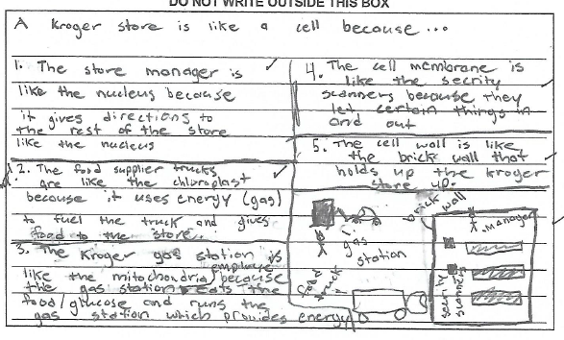
Summative Exam 3B: Question 5

Slide 6
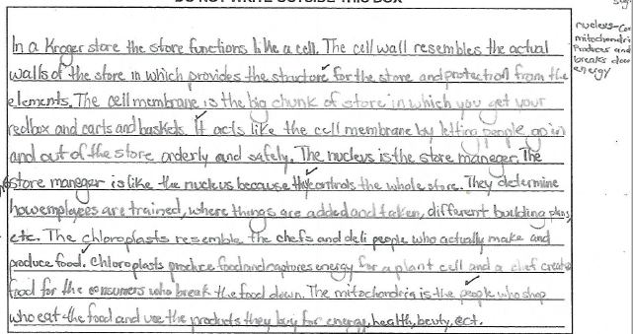
Summative Exam 3B: Question 5

Slide 7
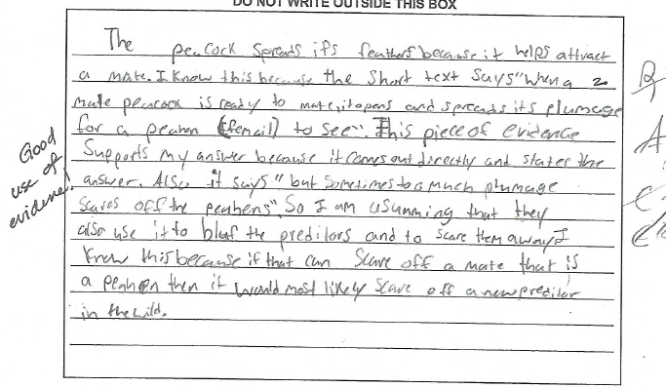
Summative Exam 3B: Question 10

Slide 8
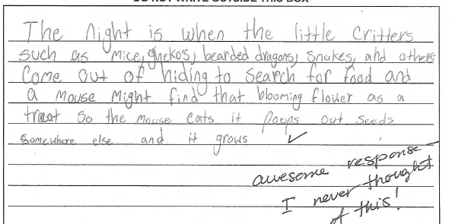
Summative Exam 3B: Question 11

Slide 9
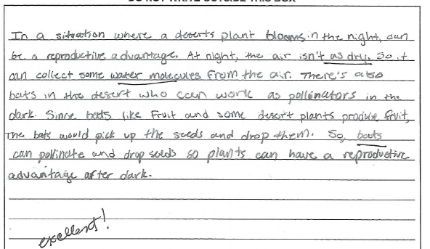
Summative Exam 3B: Question 11

Slide 10
Summative Exam 3B: Question 18

Slide 11
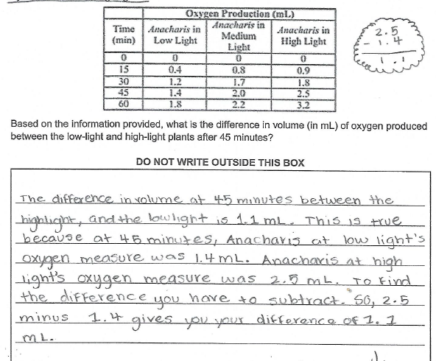
Summative Exam 3B: Question 19

Slide 12
Thursday, February 13th, 2020
Copy homework into planner:
Claim*Evidence*Reasoning for Growth of Organisms due tomorrow.
Take out supplies:
Graphic organizer for Immortal Life of Henrietta Lacks
Pencil
Science Folder
Amoeba Sisters video: The 11Champions
https://www.youtube.com/watch?v=gEUu-A2wfSE
Video guide worksheet
The Immortal Life of Henrietta Lacks
Chapter 16

Slide 13
Friday, February 14th, 2020
Copy homework into planner:
Do something to keep your healthy for 30 minutes
Take out supplies:
Pencil
Science Folder
New packet for unit 5
Human Body Basics: prompt in packet
Assign hospital specialty (record on packet)

Slide 14
3 Urology (male reproductive system) | 4 Orthopedics (Skeletal and muscular system)
2 Cardiology (Circulatory system), Pulmonology (Respiratory system), Hematology (Study of blood) | 5 Endocrinology (Endocrine system)
1 Neurology (Nervous system), Immunology (Immune system), Lymphology (Lymphatic system) | 6 Gastroenterology (Digestive system), Urology (Excretory system and male reproductive system)

Slide 15
Blake’s Illness
Video: Blake’s Doctor Visit
https://drive.google.com/drive/folders/1a-Zu3UujXrtqZd_6UCYdRK6Zd6sGkS5U
Summary (Intake notes from hospital visit)
Read “Blake’s Illness” in packet
Checkpoint 1
Complete checkpoint 1 using evidence from the video and intake (summary)

