Slide 1
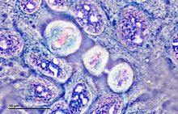
Tuesday, January 21st, 2020
Copy homework into planner:
  Individual Cell Analogy Model due Friday, January 24th
Take out supplies:
  HeLa Cells and More packet
  Pencil
  Notebook
Review…
  Animal Cell diagram
  Plant Cell Diagram
  Function and City Cell of City Cell Analogy
Work on individual cell analogy model

Slide 2
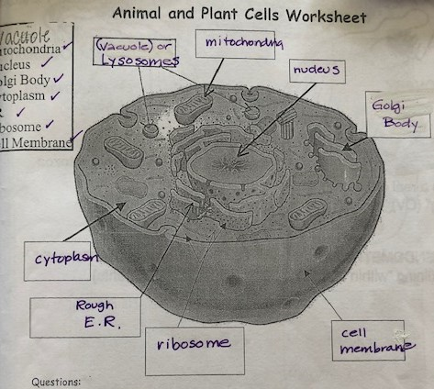
Animal Cell

Slide 3
Plant Cell

Slide 4

Cell = City
City Cell Analogy (in HeLa Cells and More packet)

Slide 5

Think of a City
How does it operate?
Who protects the city?
Who runs the city?
How does the city manage its trash?
How does the city get food?
How does the city get its power?
How do you know when you are in the city limits?

Slide 6
A cell can be compared to a city!
Each part of the cell has its own function or purpose.
The parts of the cell can be compared to the parts of a city based on their similar purpose.

Slide 7
Structure (Organelle) | Animal Cell | Plant Cell
Cell Membrane | Encloses the cell; acts like a gatekeeper--allowing some materials to pass through but not others | Encloses the cell--controls what materials enter and leave the cell
Cell Wall | xxxx | Outer barrier that provides extra support for the cell and gives it shape; made mostly of cellulose (a fiber) in plants
Cytoplasm | Gel-like fluid; mostly water with other substances | Gel-like fluid; mostly water with other substances
Nucleus | Structure usually located near the center of the animal cell; home to chromosomes | Structure usually located near the center of the animal cell; home to chromosomes
Chromosomes | Housed in nucleus; genetic structures that contain information used to direct cell activity--made of DNA (deoxyribonucleic acid) | Housed in nucleus; genetic structures that contain information used to direct cell activity--made of DNA (deoxyribonucleic acid)
DNA | Deoxyribonucleic acid; makes up chromosomes | Deoxyribonucleic acid; makes up chromosomes
Nuclear Membrane | Surrounds and protects the nucleus; has pores | Surrounds and protects the nucleus
Nucleolus | Found inside the nucleus; makes ribosomes which are transported to the cytoplasm | Found inside the nucleus; makes ribosomes which are transported to the cytoplasm
Vacuoles | Fluid-filled structures temporarily store substances needed by the cell; usually many small vacuoles in animal cells | Internal delivery system--moves proteins within the cell
Chloroplasts | xxxx | Food making structures (use sunlight energy to convert carbon dioxide and water into sugar and oxygen)
Chlorophyll | xxxx | Pigment in chloroplasts that captures the energy of sunlight during photosynthesis
Mitochondria | Use oxygen to transform energy into food to form the cell can use (glucose) | Use oxygen to transform energy into food to form the cell can use (glucose)
Endoplasmic Reticulum | Internal delivery system--moves proteins within the cell | Internal delivery system--moves proteins within the cell
Ribosomes | Produce important products for the cell, including proteins | Produce important products for the cell, including proteins
Gogi Bodies | Package products (proteins) from the endoplasmic reticulum and distribute them around the cell or outside of it | Makes cellulose; Package products (proteins) from the endoplasmic reticulum and distribute them.

Slide 8
Let’s compare!
Organelle
  Cell Wall
  Cell Membrane
  Cytoplasm
  Nucleus
  Mitochondria
  Chloroplasts
  Vacuole
  Golgi Bodies
  Endoplasmic Reticulum
  Ribosomes
  Lysosomes
  Nucleolus
City Cell Analogy
  Wooden Fence
  Border Patrol
  Open Land
  Town Hall
  Coal Power Plant
  Solar Energy Plant
  Warehouses
  Postal Office
  Special Carts
  Small Shops
  Scrap Yard
  Carpenter’s Union

Slide 9
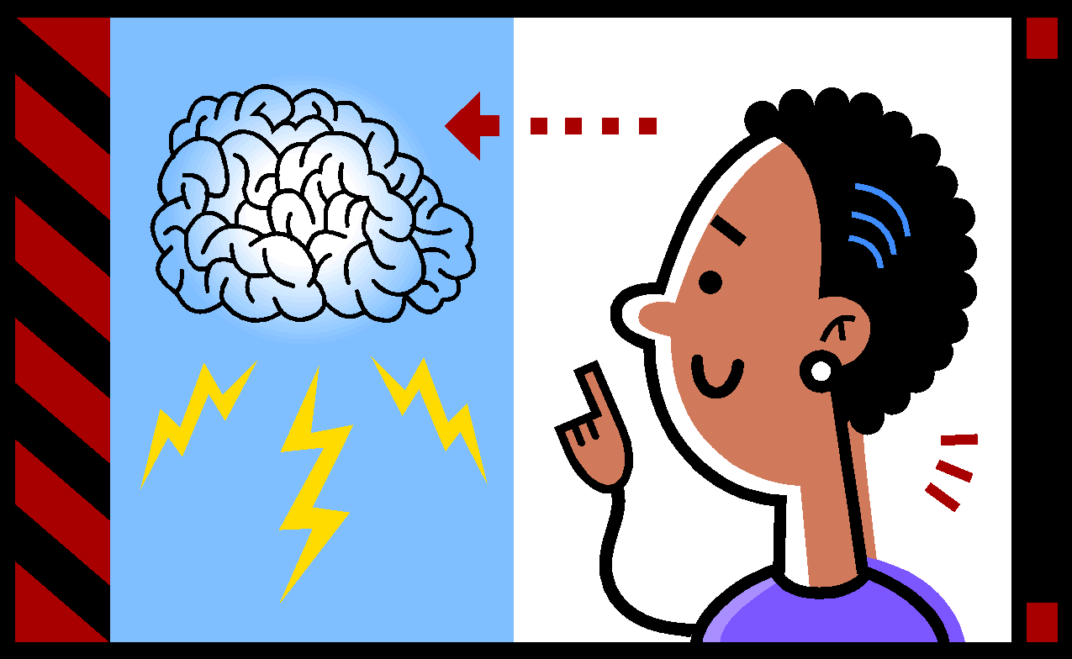
Create a Cell Analogy/Model
You can use any location/organization.
Steps of the Project:
  Step 1: Brainstorm locations/places or organizations that you are familiar with.
  Step 2: Study the function of the various cell organelles and what part of the location or organization is analogous to that cell part.
  Step 3: In your HeLa packet record in pencil in the “ANALOGY/MODEL” column what part of your model is analogous (does a similar job) to that part of the cell and why.
  Step 4: On a sheet of white paper draw your analogy/model and label the parts.
  Step 5: Label your analogy model. Include why you selected each part of your location/organization to represent the part of the cell and what function they both share. You could also create a legend or map key in the corner and explain what each represents.

Slide 10
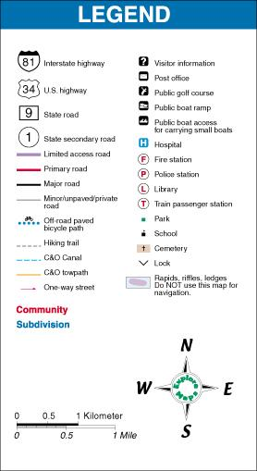


Create your map and legend.
Draw your city. Pencil first, then colored pencils or thin markers. No sharpies.
Label each part on your model analogy. Circle the letter.
Create a map legend or key which identifies the name of each place and its function in the organization or location.

Slide 12
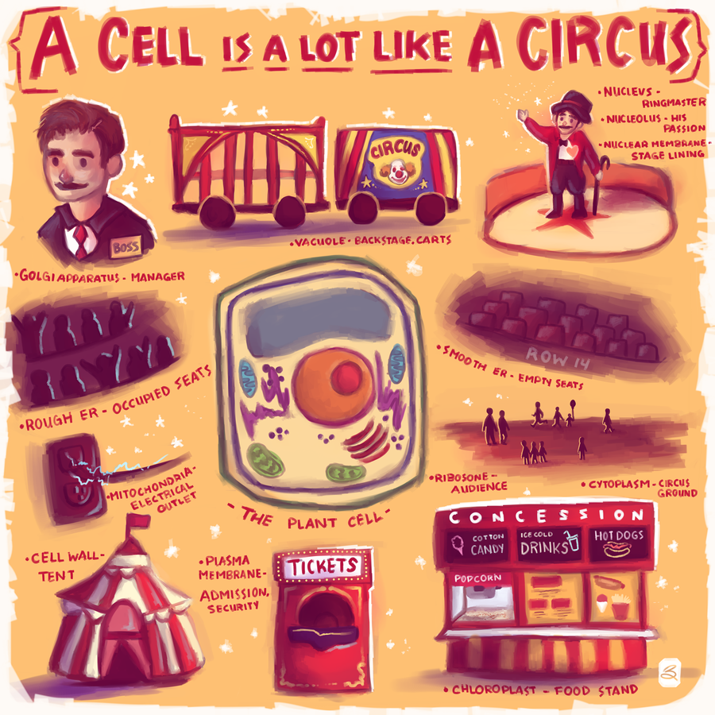

Slide 13
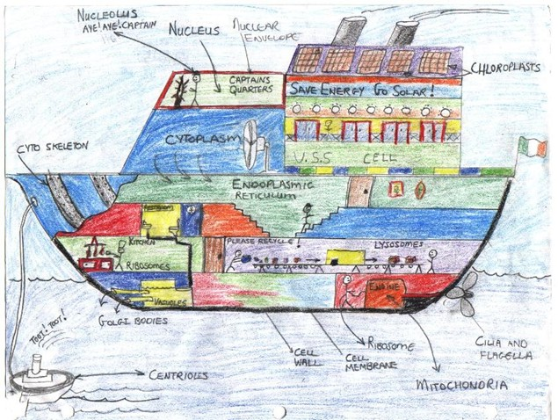

Slide 14
Wednesday, January 22nd, 2020
Copy homework into planner:
  Individual Cell Analogy Model due Friday, January 24th
Take out supplies:
  Graphic organizers
  Pencil
  Book: The Immortal Life of Henrietta Lacks
Read and Discuss
  Finish chapter 7
    https://www.youtube.com/watch?v=Bjn3TwMr4xs
  Chapter 8
  Begin Chapter 9

Slide 15
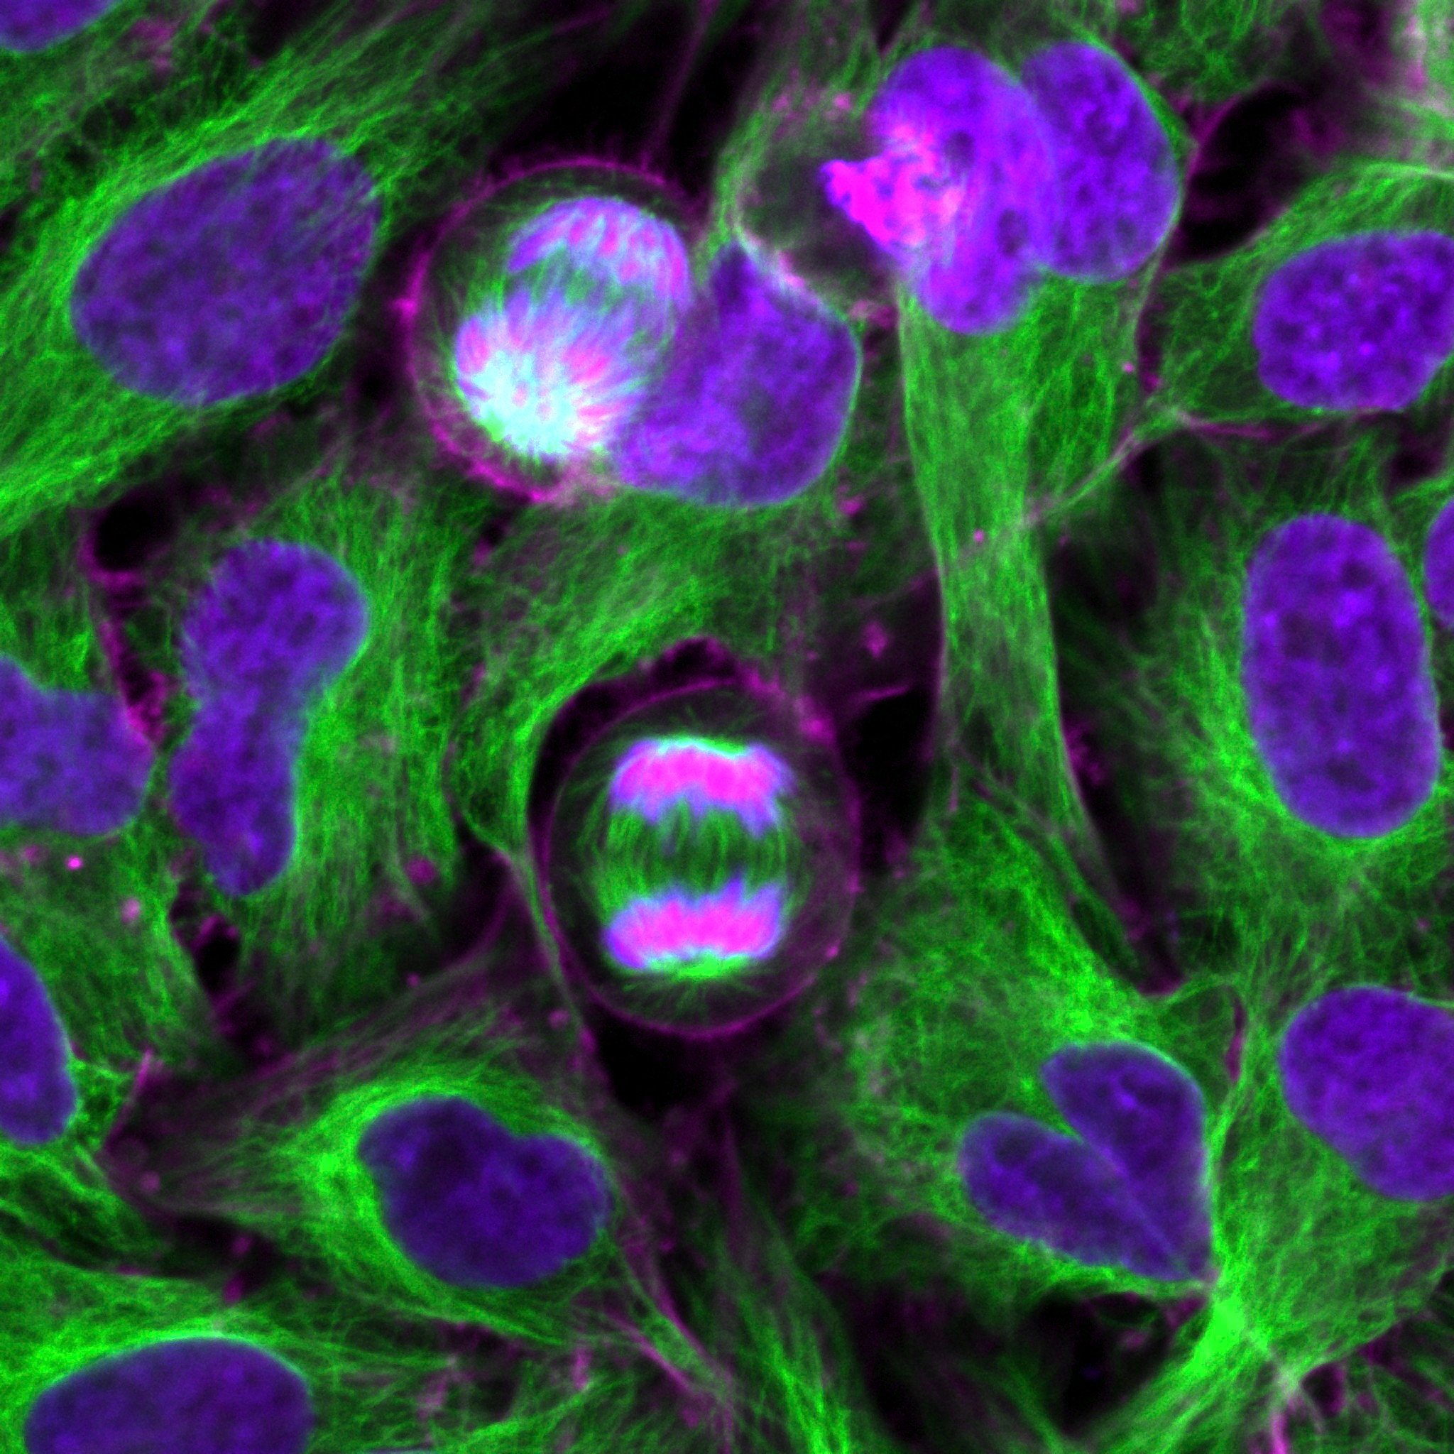
Thursday, January 23rd, 2020
Copy homework into planner:
  Individual Cell Analogy Model due TOMORROW.
Take out supplies:
  Graphic organizers
  Pencil
  Book: The Immortal Life of Henrietta Lacks
Read and Discuss
  Finish chapter 9
  Chapter 10
  Chapter 11

Slide 16
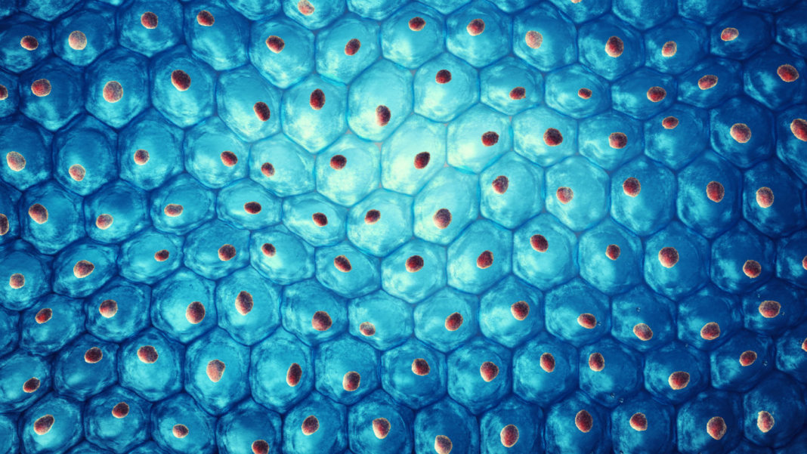
Friday, January 24th, 2020
Copy homework into planner:
  Clean and organize your bedroom☺
Take out supplies:
  HeLa Cells and More packet
  Cell Analogy Model Project
  Pencil
  Notebook/folder
“Lights Out” chicken heart radio show
  https://www.youtube.com/watch?v=G_OD_jUnYNM
  March 10th, 1937
Gallery Walk of Cell Analogy Projects.

